Slide 1
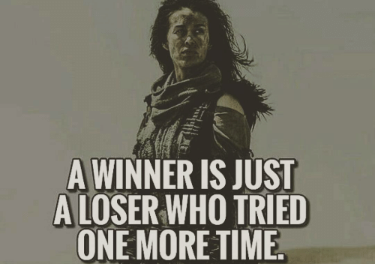
TCS NINJA / NQT : Pre-assessment

Slide 2
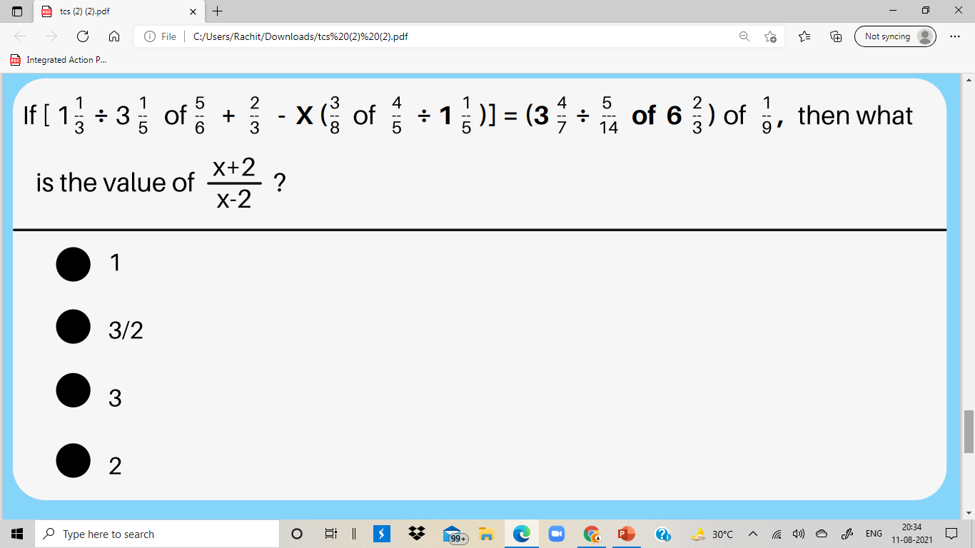


Slide 3

A is 20 km west of B. C is 30 km south of B and D is 50 km north-east of C, what will be the speed of vehicle to travel from A to D in 2 hours?

Slide 4
The cost of three erasers, five sharpeners and seven pens is ₹105. The cost of five erasers, eight sharpeners and eleven pens is ₹166. What is cost (in ₹) of one eraser, two sharpeners and 3 pens?
44 52
54 46

Slide 5
At a certain fast food restaurant, Amit can buy 3 burgers, 7 shakes and one order of fries for Rs. 120. At the same place, it would cost Rs. 164.50 for 4 burgers, 10 shakes and one order of fries. How much would it cost for an ordinary meal of one burger, one shake and one order of fries?
ARs. 31
BRs. 41
CRs. 21
DCannot be determined

Slide 6
A mixture contains milk and water in the ratio of 9 : 11. If 24 liters of water is added with y amount of milk the ratio becomes 1 : 1. if 66 liters of water was there in the mixture, then find y.
48 Liters 40 Liters 36 Liters 28 Liters

Slide 7
A box contains x paper sticks, x + 3 plastic sticks and x + 7 wooden sticks If the probability of getting one plastic and one wooden stick is 32%, then find the total number of sticks
35
25
15
40

Slide 8

Find the ratio between quantity (1) and (2) .
1 . A box contains 'a' pens and 12 pencils. If getting probability of getting a pen is 5/8, then the probability of getting a pen and pencil from the beg.
2 . A bag contains 15 orange and 10 mango candies. If two candies are taken without replacement, then find the probability that both are different.

Slide 9
A and B borrowed a total sum of $20,300 at 12.5% p.a. compound interest, compounded yearly in such a way that A paid as much an amount after 3 years as B paid after 5 years, from the date of borrowing. If the borrowed by A exceeds the sum borrowed by B $x, what is the value of x?
A)2380 B) 2240
C)2560 D)2610

Slide 10


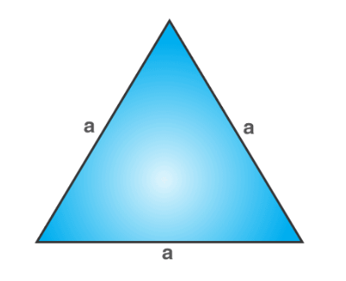
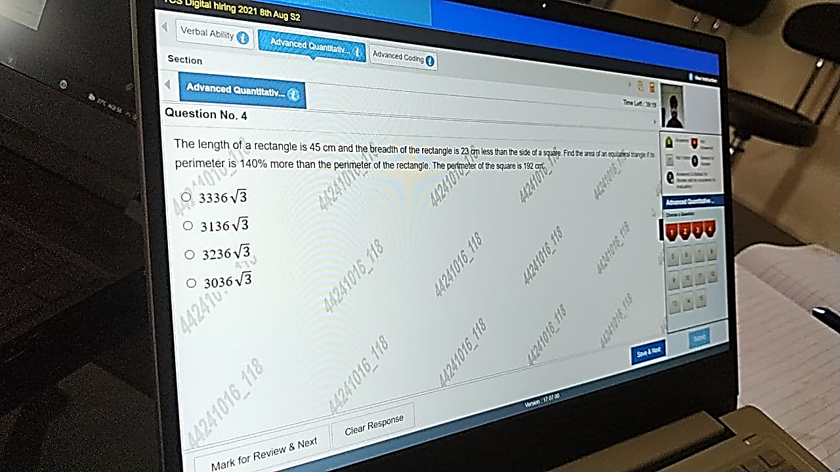
The length of a rectangle is 45 cm and the breadth of the rectangle is 23 cm less than the side of a square. Find the area of an equivalent triangle if it's perimeter is 140% more than the perimeter of the rectangle. The perimeter of the square is 192 cm

Slide 11
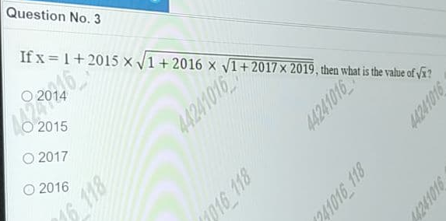

Slide 12
16 men and 12 women can complete a job in 20 days. If 15 women can complete the job in 40 days, then determine the number of days required by 20 men to complete the job

Slide 13


